Slide 1
AZ-104T00A Administer Network Traffic
Notes:
These Learn modules are part of the AZ-104: Configure and manage virtual networks for Azure administrators (https://docs.microsoft.com/learn/paths/az-104-manage-virtual-networks/) learning path.

Slide 2



Administer Network Traffic Introduction
Configure Azure Load Balancer
Configure Application Gateway
Configure Network Watcher
Lab 06 – Implement Traffic Management

Slide 3
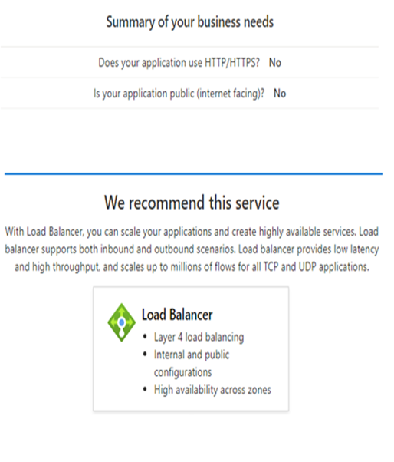
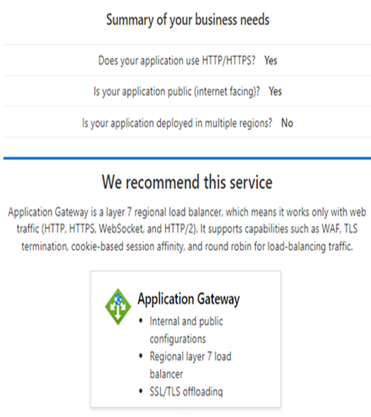
Administer Network traffic whiteboard (walkthrough) and review
What is a load balancer and when should it be used?
What are the four types of Azure load balancers? Describe the differences.
The portal provides a Help me Choose questionnaire
Notes:
Optional whiteboard slide to introduce the module or review the content. Use the whiteboard diagram directly or recreate the image during the class.
The Azure portal has a Help me Choose section for load balancers. Take a few minutes to walk through the choices showing the different combinations that are suggested. Global balancers, like Traffic Manager and Front Door, are not covered in the course.
Here is the Load Balancing flow chart - https://learn.microsoft.com/azure/architecture/guide/technology-choices/load-balancing-overview
What is a load balancer and what two types of load balancer does Azure provide? Give an example of where each type of load balancer would be used.
Answer: A load balancer distributes inbound and outbound traffic using load-balancing rules and health probes. There are two types of load balancers: public and internal. Public facing load balancers maps external IP addresses to internal IP addresses, and vice versa. Public load balancers handle external requests to backend resources, like SQL servers. Internal load balancers direct traffic only to resources inside a virtual network or that use a VPN. Internal load balancers can be used for cross-premises virtual networks, for multi-tier applications, and for line-of-business application balancing.
List the Azure load balancer types. For each load balance describe the usage scenarios.
Answer: The Application Gateway can optimize delivery from application server farms while increasing application security with web application firewall. Front Door is a scalable, security-enhanced delivery point for global, micro service-based web applications. The Azure Load Balancer balances inbound and outbound connections and requests to your applications or server endpoints. Traffic Manager distributes traffic optimally to services across global Azure regions, while providing high availability and responsiveness.
Your retail application allows customers to select and save items for purchase. It is important if the customer returns to the website that they are connected to the same virtual machine they previously used. What distribution methods does the Load Balancer have to handle these requests?
Answer: Session persistence specifies how client traffic is handled. The default is that requests are handled by any machine. The Client IP requests will be handled by the same virtual machine. Client IP and protocol specifies that successive requests from the same address and protocol will be handled by the same virtual machine.
Your website uses static image and video. The images and video are located on different backend servers. What solution would you put in place to handle the requests?
Answer: An Application Gateway manages web app requests. The Application Gateway can route traffic to a pool of web servers based on the URL of a request. In this case path-based routing can send URL images to one server and URL videos to another server. Multiple-site routing is also available. For example, one set of servers for one organization and another set of servers for a different organization.
Name at least three ways to use Network Watcher to troubleshoot and diagnose network problems.
Answer: Network Watcher is a regional service that provides various network diagnostic and monitoring tools​. IP Flow Verify diagnoses connectivity issues. Next Hop determines if traffic is being correctly routed. VPN Diagnostics troubleshoots gateways and connections. NSG Flow Logs maps IP traffic through a network security group. Connection Troubleshoot shows connectivity between source VM and destination. Topology generates a visual diagram of resources that might be helpful.

Slide 4
Configure Azure Load Balancer

Slide 5
Configure Azure Load Balancer Introduction
Choose a Load Balancer Solution
Implement a Public Load Balancer
Implement an Internal Load Balancer
Determine Load Balancer SKUs
Create Load Balancer Rules
Demonstration – Configure a load balancer
Summary and Resources
Notes:
Implement and manage virtual networking (15–20%)
Configure name resolution and load balancing
Configure an internal or public load balancer
Troubleshoot load balancing

Slide 6
Choose a Load Balancer Solution
Feature | Application Gateway | Front Door | Load Balancer | Traffic Manager
Usage | Optimize delivery from application server farms while increasing application security with web application firewall. | Scalable, security-enhanced delivery point for global, micro service-based web applications. | Balance inbound and outbound connections and requests to your applications or server endpoints. | Distribute traffic optimally to services across global Azure regions, while providing high availability and responsiveness.
Protocols | HTTP, HTTPS, HTTP2 | HTTP, HTTPS, HTTP2 | TCP, UDP | Any
Private (regional) | Yes |  | Yes
Global |  | Yes |  | Yes
Env | Azure, non-Azure cloud, on premises | Azure, non-Azure cloud, on premises | Azure | Azure, non-Azure cloud, on premises
Security | WAF | WAF, NSG | NSG
Notes:
This slide is not in the student materials. It is designed to help students understand that the Azure Load Balancer is not the only product solution.
Use the portal and the “Load Balancing – help me choose” page to review the options. Application Gateway is Layer 7. Load Balancer is Layer 4.
Load-balancing options - Azure Architecture Center | Microsoft Docs - https://docs.microsoft.com/azure/architecture/guide/technology-choices/load-balancing-overview
Does your application use HTTP/HTTPS?
Is your application public (internet facing)?
Is your application deployed in multiple regions?

Slide 7
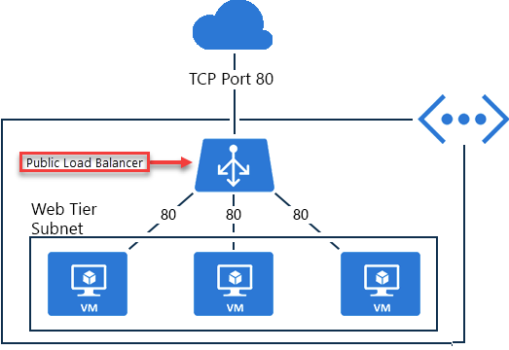
Implement a Public Load Balancer
Maps public IP addresses and port number of incoming traffic to the VM’s private IP address and port number, and vice versa
Apply load balancing rules to distribute traffic across VMs or services

Slide 8
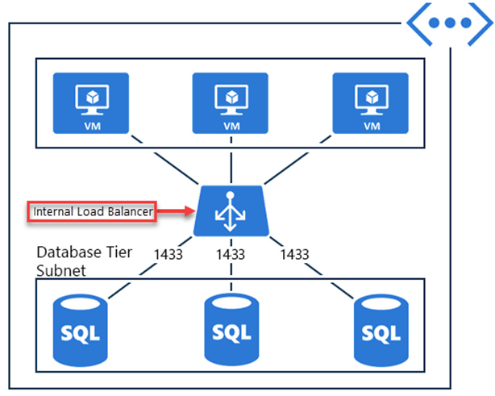
Implement an Internal Load Balancer
Directs traffic only to resources inside a virtual network or that use a VPN to access Azure infrastructure
Frontend IP addresses and virtual networks are never directly exposed to an internet endpoint
Enables load balancing within a virtual network, for cross-premises virtual networks, for multi-tier applications, and for line-of-business applications
Notes:
✔ Can you see how a public load balancer could be placed in front of the internal load balancer to create a multi-tier application.

Slide 9
Determine Load Balancer SKUs
Feature | Basic SKU | Standard SKU
Backend pool size | 300 IP configurations, single availability set | Up to 5000 instances
Health probes | TCP, HTTP | TCP, HTTP, HTTPS
Availability zones | Not available | Zone-redundant and zonal frontends for inbound and outbound traffic
Multiple frontends | Inbound only | Inbound and outbound
Secure by default | By default, open to the internet | Closed to inbound connections unless opened by NSGs
SLA | Not available | 99.99%
Notes:
Load balancer SKUs - https://docs.microsoft.com/azure/load-balancer/skus

Slide 10
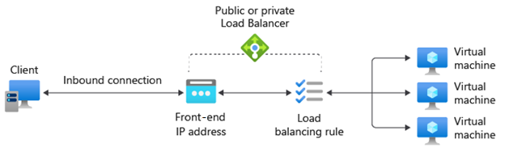
Create load balancer rules
Maps a frontend IP and port combination to a set of backend pool and port combination
Rules can be combined with NAT rules
A NAT rule is explicitly attached to a VM (or network interface) to complete the path to the target
Notes:
Tutorial: Load balance internet traffic to VMs using the Azure portal - https://docs.microsoft.com/azure/load-balancer/tutorial-load-balancer-standard-manage-portal
✔ Can you see the difference between load balancing rules and NAT rules? Remember, this approach should only be used when you need connectivity from the Internet. Most normal communications would occur from on-premises to Azure connections such as site-to-site VPN and ExpressRoute.

Slide 11
Demonstration – Configure a Load Balancer
Portal – Help me choose a load balancer
Configure a load balancer
Notes:
Quickstart: Create a public load balancer to load balance VMs using the Azure portal - https://learn.microsoft.com/azure/load-balancer/quickstart-load-balancer-standard-public-portal

Slide 12
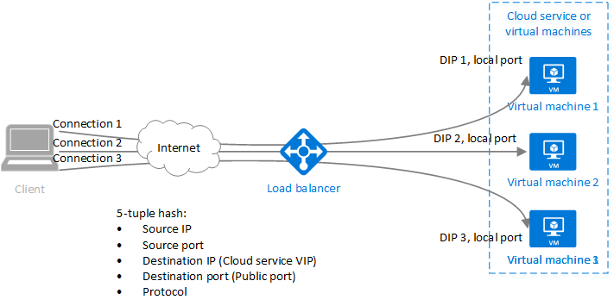
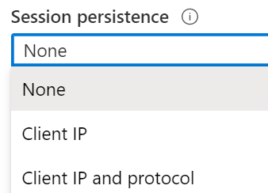
Configure Session Persistence (optional)
Session persistence specifies how client traffic is handled
None (default) requests can be handled by any virtual machine
Client IP requests will be handled by the same virtual machine
Client IP and protocol specifies that successive requests from the same address and protocol will be handled by the same virtual machine
Notes:
The student materials have a Health Probes topic. The slide is at the end if you need it.
✔ Keeping session persistence information is very important in applications that use a shopping cart. Can you think of any other applications?

Slide 13
Summary and Resources – Configure Azure Load Balancer
Knowledge Check Questions
Microsoft Learn Modules (docs.microsoft.com/Learn)
Improve application scalability and resiliency by using Azure Load Balancer (Sandbox)
Load balance non-HTTP(S) traffic in Azure
Introduction to Azure Load Balancer
A sandbox indicates a hands-on exercise.
Notes:
Learn - https://docs.microsoft.com/learn/browse
The Assessment Guide in the MCT DLC has open-ended questions.
What is a load balancer and what two types of load balancer does Azure provide? Give an example of where each type of load balancer would be used.
Answer: A load balancer distributes inbound and outbound traffic using load-balancing rules and health probes. There are two types of load balancers: public and internal. Public facing load balancers maps external IP addresses to internal IP addresses, and vice versa. Public load balancers handle external requests to backend resources, like SQL servers. Internal load balancers direct traffic only to resources inside a virtual network or that use a VPN. Internal load balancers can be used for cross-premises virtual networks, for multi-tier applications, and for line-of-business application balancing.
List at least three types of Azure load balancers. For each load balance describe the usage scenarios.
Answer: The Application Gateway can optimize delivery from application server farms while increasing application security with web application firewall. Front Door is a scalable, security-enhanced delivery point for global, micro service-based web applications. The Azure Load Balancer balances inbound and outbound connections and requests to your applications or server endpoints. Traffic Manager distributes traffic optimally to services across global Azure regions, while providing high availability and responsiveness.

Slide 14
Configure Azure Application Gateway
Notes:
Configure and manage virtual networking (25–30%)
Configure load balancing
* Configure Azure Application gateway.

Slide 15
Configure Azure Application Gateway Introduction
Implement Application Gateway
Determine Application Gateway Routing
Demonstration – Configure an Application Gateway
Setup Application Gateway Components
Summary and Resources
Notes:
Configure and manage virtual networking (20–25%)
Configure load balancing
Configure Azure Application Gateway

Slide 16
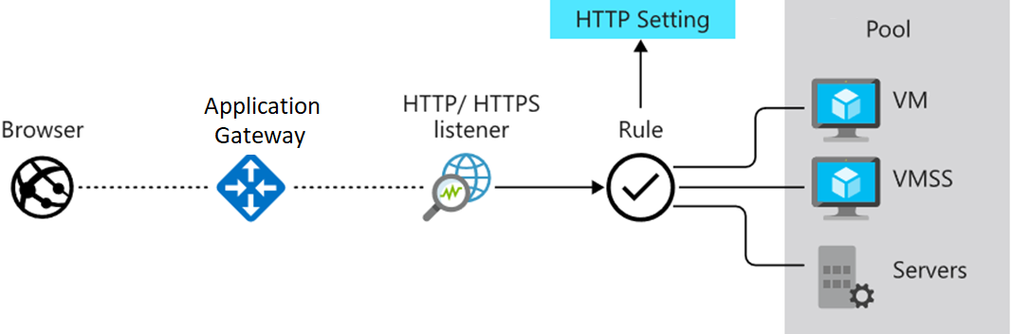
Implement Application Gateway
Manages web app requests
Routes traffic to a pool of web servers based on the URL of a request
The web servers can be Azure virtual machines, Azure virtual machine scale sets, Azure App Service, and even on-premises servers
Notes:
Application Gateway configuration overview - https://docs.microsoft.com/azure/application-gateway/configuration-overview

Slide 17
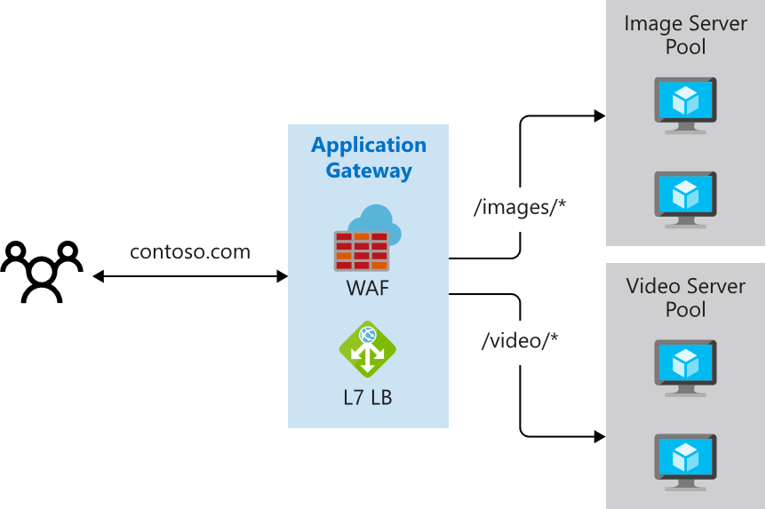
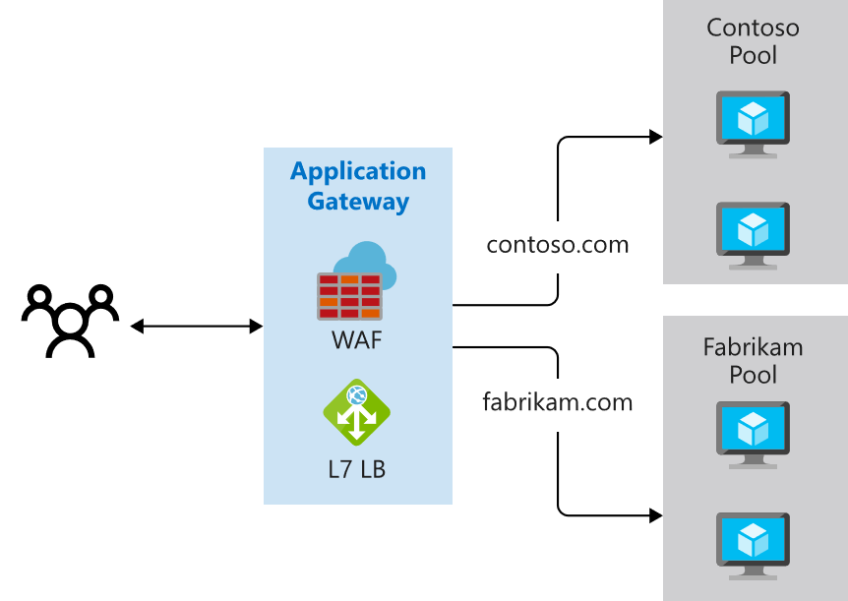
Determine Application Gateway Routing
Path-based routing
Multiple-site routing
Notes:
QuickStart: Direct web traffic with Azure Application Gateway - Azure portal - https://docs.microsoft.com/azure/application-gateway/quick-create-portal

Slide 18
Demonstration – Configure an Azure Application Gateway
Configure the Azure Application Gateway
Compare to the Load Balancer
Notes:
Quickstart: Direct web traffic with Azure Application Gateway - Azure portal - https://learn.microsoft.com/azure/application-gateway/quick-create-portal

Slide 19
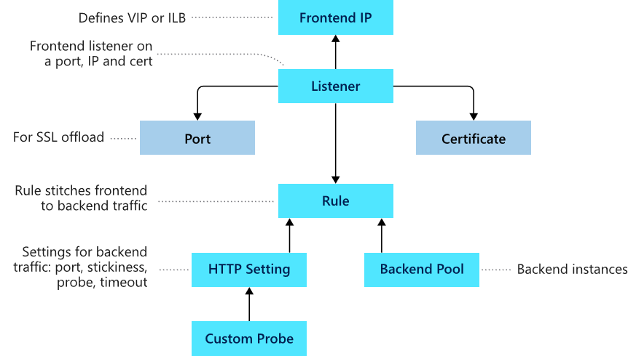
Setup Application Gateway Components (optional)
Frontend IP
Listeners
Routing rules
Backend pools
Web application firewall (optional)
Health probes
Notes:
Load balance your web service traffic with Application Gateway - https://docs.microsoft.com/learn/modules/load-balance-web-traffic-with-application-gateway/

Slide 20
Summary and Resources – Configure Azure Application Gateway
Knowledge Check Questions
Microsoft Learn Modules (docs.microsoft.com/Learn)
Introduction to Azure Application Gateway
Load balance your web service traffic with Application Gateway
Load balance HTTP(S) traffic in Azure
Encrypt network traffic end to end with Azure Application Gateway
Notes:
Learn - https://docs.microsoft.com/learn/browse
The Assessment Guide in the MCT DLC has open-ended questions.
Your website uses static image and video. The images and video are located on different backend servers. What solution would you put in place to handle the requests?
Answer: An Application Gateway manages web app requests. The Application Gateway can route traffic to a pool of web servers based on the URL of a request. In this case path-based routing can send URL images to one server and URL videos to another server. Multiple-site routing is also available. For example, one set of servers for one organization and another set of servers for a different organization.

Slide 21
Configure Network Watcher

Slide 22
Configure Network Watcher Introduction
Describe Network Watcher Features
Review IP Flow Verify Diagnostics
Review Next Hop Diagnostics
Visualize the Network Topology
Summary and Resources
Notes:
Configure and manage virtual networking (20–25%)
Monitor virtual networking
Configure and use Azure Monitor for networks
Use Azure Network Watcher

Slide 23
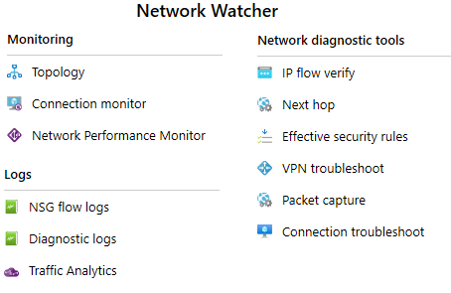
Describe Network Watcher Features
A regional service that provides various network diagnostic and monitoring tools​
IP Flow Verify diagnoses connectivity issues
Next Hop determines if traffic is being correctly routed
VPN Diagnostics troubleshoots gateways and connections
NSG Flow Logs maps IP traffic through a network security group
Connection troubleshoot shows connectivity between source VM and destination
Topology generates a visual diagram of resources

Slide 24
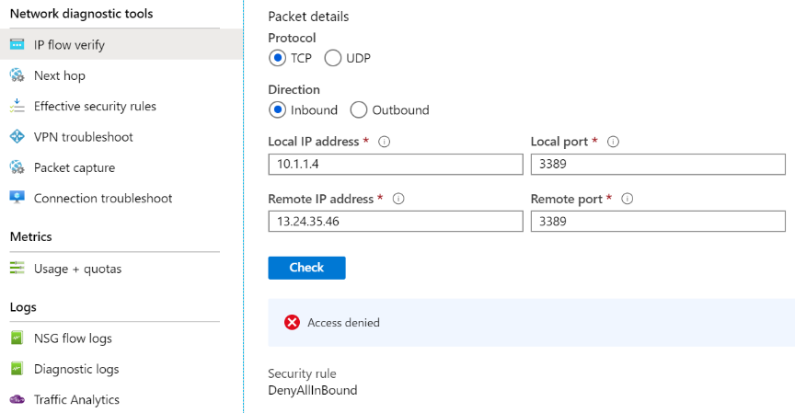
Review IP Flow Verify Diagnostics
Checks if a packet is allowed or denied to or from a virtual machine
Notes:
Introduction to IP flow verify in Azure Network Watcher - https://docs.microsoft.com/azure/network-watcher/network-watcher-ip-flow-verify-overview
Command line equivalent might be ping.

Slide 25
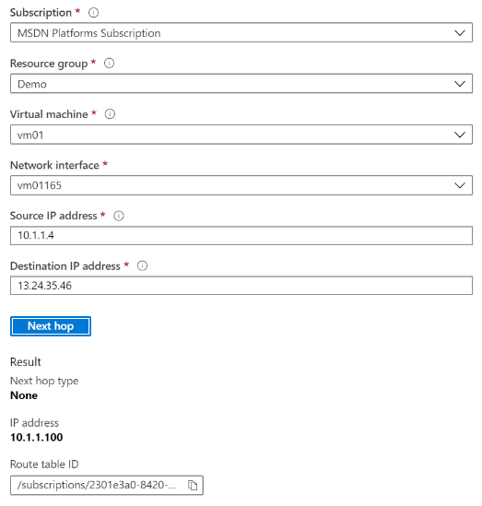
Review Next Hop Diagnostics
Helps with determining whether traffic is being directed to the intended destination by showing the next hop
Notes:
Use next hop to diagnose virtual machine routing problems - https://docs.microsoft.com/azure/network-watcher/network-watcher-next-hop-overview
Command line equivalent might be traceroute. (tracert).

Slide 26
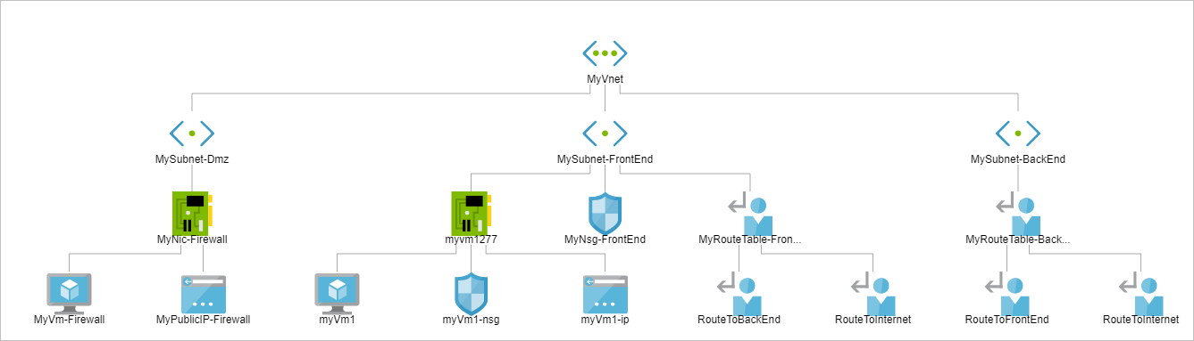
Visualize the Network Topology
Provides a visual representation of your networking elements
View all the resources in a virtual network, resource to resource associations, and relationships between the resources
The Network Watcher instance in the same region as the virtual network
Notes:
View the topology of an Azure virtual network - https://docs.microsoft.com/azure/network-watcher/view-network-topology

Slide 27
Summary and Resources – Configure Network Watcher
Knowledge Check Questions
Microsoft Learn Modules (docs.microsoft.com/Learn)
Introduction to Azure Network Watcher
Monitor and troubleshoot your end-to-end Azure network infrastructure by using network monitoring tools
Analyze your Azure infrastructure by using Azure Monitor logs (Sandbox)
Monitor the performance of virtual machines using Azure Monitor VM Insights (Sandbox)
Write your first query with Kusto Query Language
A sandbox indicates a hands-on exercise.
Notes:
https://docs.microsoft.com/learn/
The Assessment Guide in the MCT DLC has open-ended questions.
Name at least three ways to use Network Watcher to troubleshoot and diagnose network problems.
Answer: Network Watcher is a regional service that provides various network diagnostic and monitoring tools​. IP Flow Verify diagnoses connectivity issues. Next Hop determines if traffic is being correctly routed. VPN Diagnostics troubleshoots gateways and connections. NSG Flow Logs maps IP traffic through a network security group. Connection Troubleshoot shows connectivity between source VM and destination. Topology generates a visual diagram of resources that might be helpful.

Slide 28
Lab – Implement Traffic Management

Slide 29
Lab 06 – Implement traffic management
Scenario
You are tasked with implementing a hub spoke topology for network traffic. The topology should include an Azure Load Balancer and Azure Application Gateway.
Objectives
Task 1: Provision the lab environment
Task 2: Configure the hub and spoke network topology
Task 3: Test transitivity of virtual network peering
Task 4: Configure routing in the hub and spoke topology
Task 5: Implement Azure Load Balancer
Task 6: Implement Azure Application Gateway
Next slide for an architecture diagram
Notes:
LAB 06 - Implement Traffic Management - ESTIMATED DURATION 60 MIN
Lab Repository - https://microsoftlearning.github.io/AZ-104-MicrosoftAzureAdministrator/
This issue discusses how to use Lab 05 and Lab 06 - https://github.com/MicrosoftLearning/AZ-104-MicrosoftAzureAdministrator/issues/726

Slide 30






Lab 06 – Architecture Diagram
Task6
Task1
az104-06-rg5
az104-06-rg1
az104-06-vnet01 10.60.0.0/22
Subnet0 10.60.0.0/24
Subnet1 10.60.1.0/24
Subnet-appgw 10.60.3.224/27
az104-06-appgw5
az104-06-vm0
10.60.0.4
az104-06-vm1
10.60.1.4
az104-06-pip5
Task2, Task3
Peering
Peering
Task4
Task5
Subnet0 10.63.0.0/24
Task4
Subnet0 10.62.0.0/24
az104-06-rt23
az104-06-vm2
10.62.0.4
az104-06-lb4
az104-06-vm3
10.63.0.4
az104-06-rt32
az104-06-vnet2 10.62.0.0/22
az104-06-pip4
az104-06-vnet3 10.63.0.0/22
az104-06-rg4
az104-06-rg1
az104-06-rg1
Notes:
Break down the explanation by reviewing the components in each of the three virtual networks.

Slide 31

End of presentation

Slide 32
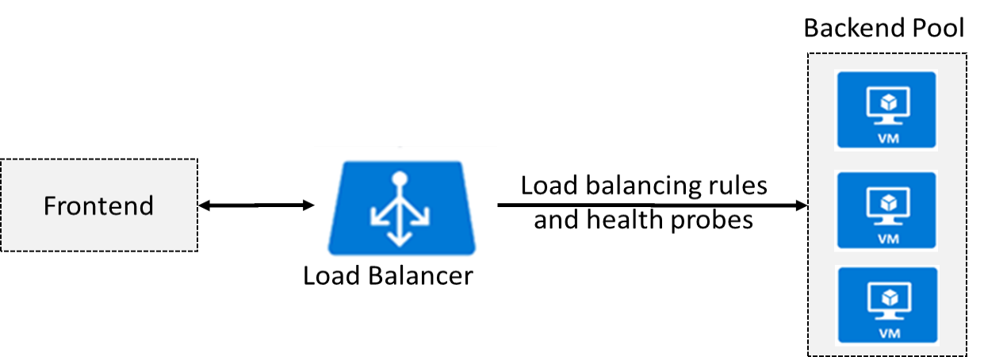
Determine Azure Load Balancer Uses
Distributes inbound traffic to backend resources using load-balancing rules and health probes
Can be used for both inbound/outbound scenarios
Two types: Public and Internal
Notes:
What is Azure Load Balancer? - https://docs.microsoft.com/azure/load-balancer/load-balancer-overview
Azure Load Balancer Components - https://docs.microsoft.com/azure/load-balancer/components
✔ Keep this diagram in mind since it covers the four components that must be configured for your load balancer: Frontend IP configuration, Backend pools, Health probes, and Load balancing rules.

Slide 33
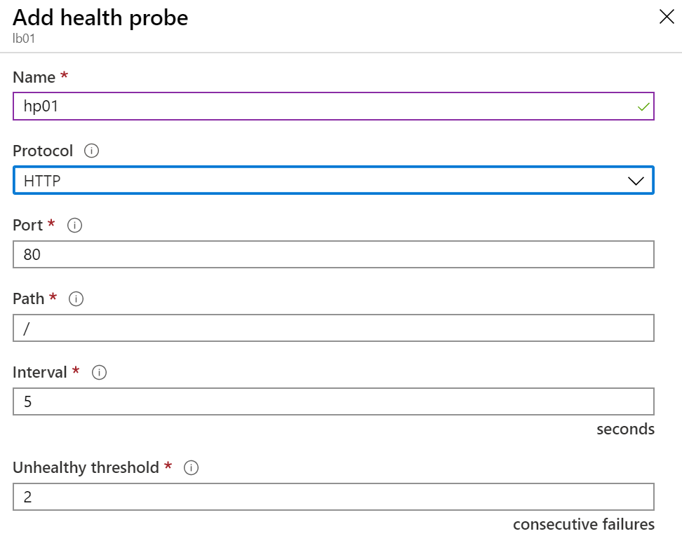
Create Health Probes
Allows the load balancer to monitor the status of an app
Dynamically adds or removes VMs from the load balancer rotation based on their response to health checks
HTTP custom probe (preferred) pings every 15 seconds
TCP custom probe tries to establish a successful TCP session
Notes:
Load Balancer health probes - https://docs.microsoft.com/azure/load-balancer/load-balancer-custom-probe-overview
✔ There is also a guest agent probe. This probe uses the guest agent inside the VM. It is not recommended when HTTP or TCP custom probe configurations are possible. Relate back to the original diagram to ensure all the components are covered.

